Slide 1

Sharmistha Dey

Slide 2
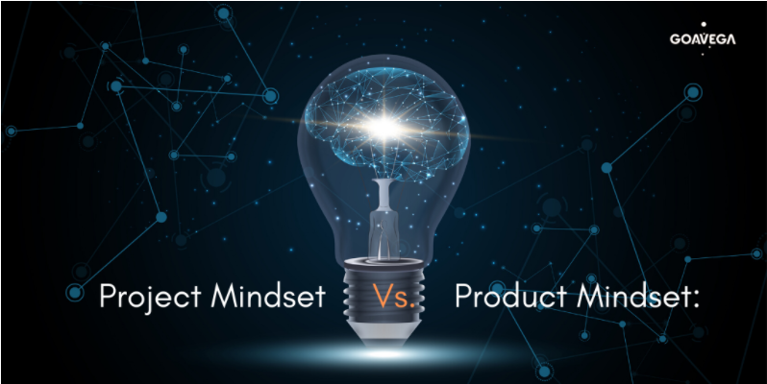
Project Mindset vs Product Mindset

Slide 3
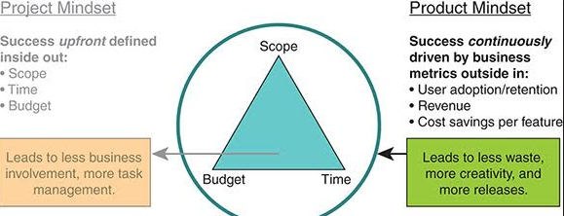
Project Mindset
Project is abbreviated as “pro” means before and “ject” means doing.
Project refers to a specific objective to create a product that is predefined with a clear start and end date.
Project essentially contained the planning part and the execution part.
Primary management is on the timeline and schedule.

Slide 4
Examples of Project Management
Purchasing a flat before construction ,you can construct it as per your guidelines and requirement.
2) Banking project like ICII,HDFC and e-commerce project like Flipkart and bigbasket.com.
These are specific to clients.

Slide 5
Role of a Project manager
Project managers are leaders—they not only ensure projects are delivered on time and in minimal budget, but must also engage, encourage and inspire their teams and clients.
The ultimate goal of a Project Manager is to maximize quality while minimizing the risk.
It manages the scope of the project, as they ensure time, cost, and quality. For example, if the deadline of a project is shortened, Project Managers must either increase costs or reduce the scope in order to maintain quality.

Slide 6
What is Project Management?
A process is a series of actions performed by a team of people who work towards the same goal.
There are basically 5 types of project management processes:
Initiating: Requirements are gathered which are required for the project.
Planning: Creating a workable scheme that will include clearly defined activities, cost estimates, schedule development, and resource planning.
Executing: Carrying out the processes which are followed by regular information distribution and team development.
Monitoring and Controlling: Controlling quality of the project results, observing significant changes and making necessary adjustments to the project.
Closing: Gathering all the necessary data to ensure that the project is completed.

Slide 7
Product Mindset
A product is designed to continually create value for customers by solving their problems.
In product mindset, mainly we focus on the goal we want to achieve or the job to be done. We aren’t set on dates and timelines.
Product development is not a temporary or occasional endeavour. It is a continuous process of delivering new features and improving a given product over time.
A product can only be developed within the context of a project, and multiple projects can occur within a product’s life cycle.

Slide 8
Responsibilities of a Product Manager
Product Manager aims to maximize the value and create new revenue streams.
Understanding and representing of the user needs.
Monitoring the market and developing competitive analysis.
Defining a vision for a product.
Aligning stakeholders around the vision for product.
Prioritizing product features and capabilities.
Communicates product plans and strategies with management to obtain required decisions ,resources or management support and minimize surprises.
The Product Manager gathers needed customer feedback to guide making sound decisions for the project.
It manages the product life-cycle and determines when actions are needed to upgrade, improve, revise or reposition products, or when actions are needed to revise product promotional programs and product pricing.

Slide 9
What is Product Management?
Product Management can be defined as the general business structure within a company that supports and manages all the activities related to developing, marketing and selling a product.
Its goal is to deliver value to the business, product management professionals play a strategic role in determining the necessary actions for achieving these goals.
Product management’s general business purposes are to make the product value for its targeted customer while producing measurable benefits that make every business viable such as revenue, profit margins etc.

Slide 10
Project vs Product
A project has a defined beginning and end in time and is unique in that it is not a routine operation, but a specific set of operations designed to accomplish a singular goal and often includes people who don’t usually work together. At the end of a project, the team is usually disbanded and assigned to new projects with new team members.
On the other hand, a product is a good, service, platform, application, system, etc. that is created, maintained and supported by solving problems and providing benefits to specific customer and business needs. Products tend to be maintained by a stable group of individuals who do work together regularly and who bring in others as needed.

Slide 11
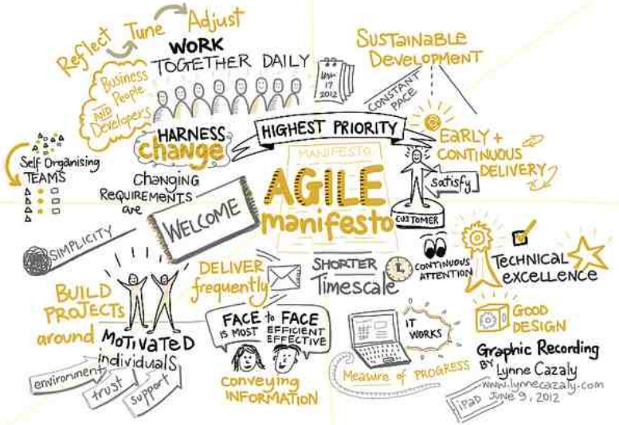
Agile Manifesto

Slide 12
Agile Manifesto- The Agile Manifesto is a document that sets out the key values and principles behind the Agile philosophy and serves to help development teams work more efficiently and sustainably. The manifesto was designed to empower developers, to speed up processes and to help encourage working practices that focus more directly on the user. Published in February 2001, the manifesto has since formed the basis of a vast array of frameworks, methodologies and different ways of working. In early 2001, a group of 17 developers held two meetings — the first in Oregon, the second in Snowbird, Utah — to discuss issues and solutions in software development, which is how the manifesto was firstborn.
The beauty of the Agile Manifesto is that despite changes the industry has seen, despite the passage of time, and despite the fact that it has been applied to sectors and organizations far and beyond its original scope — the manifesto’s flexibility and adaptive nature mean that it continues to be relevant today.
The 4 Agile Values:
Individuals and interactions over processes and tools.
Working software over comprehensive documentation.
Customer collaboration over contract negotiation.
Responding to change over following a plan.

Slide 13
12 Agile Principles:
Customer satisfaction-The highest priority is to satisfy the customer through early, and continuous, delivery of valuable software.
Welcome Change-Welcome changing requirements, even late in development. Agile processes harness change for the customer's competitive advantage.
Deliver a working software-Deliver working software frequently, from a couple of weeks to a couple of months, with a preference to the shorter timescale.
Collaboration-Clients and developers must work together daily throughout the project.
Motivation-Build projects around motivated individuals. Give them the environment and support they need, and trust them to get the job done.
Face to face conversation-The most efficient and effective method of conveying information to, and within a development team, is face-to-face conversation.
Measure the progress as per the working software-Working software is the primary measure of progress.
Maintain constant page-Agile processes promote sustainable development the sponsors, developers, and users should be able to maintain a constant pace indefinitely.
Monitoring-Continuous attention to technical excellence and good design enhances agility.
Simplicity-The art of maximizing the amount of work not done is essential.
Self organized team-The best architectures, requirements, and designs emerge from self-organizing teams.
Review the work regularly-At regular intervals, the team reflects on how to become more effective, then tunes and adjusts its behavior accordingly.

Slide 14
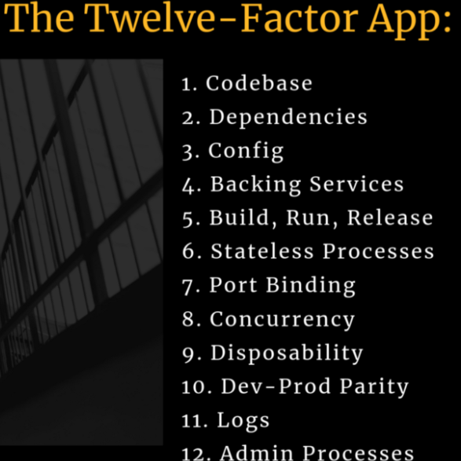
12 Factors

Slide 15
12 Factor-
In the modern era, software is commonly delivered as a service: called web apps, or software-as-a-service. The twelve-factor app is a methodology for building software-as-a-service apps that:
Use declarative formats for setup automation, to minimize time and cost for new developers joining the project;
Have a clean contract with the underlying operating system, offering maximum portability between execution environments;
Are suitable for deployment on modern cloud platforms, obviating the need for servers and systems administration;
Minimize divergence between development and production, enabling continuous deployment for maximum agility;
And can scale up without significant changes to tooling, architecture, or development practices.
The twelve-factor methodology can be applied to apps written in any programming language, and which use any combination of backing services (database, queue, memory cache, etc).
The goal of the twelve-factor framework is to help developers build apps that use an architecture that ensures speed, reliability, agility, portability and ultimately results in a robust and reliable application.
Why this?-
Nowadays everyone is building microservices. No matter where you work, either in a startup or a big company you will encounter microservices architecture. Heroku did a great job at defining what makes a solid baseline for standing up your architecture.
In 2011 Adam Wiggins [Heroku co-founder] published The Twelve-Factor App methodology for building software-as-a-service based on their own experiences. It is technology and language agnostic but successfully compatible with Microservices, Containers and CI/CD Pipelines with a focus on DevOps, hence, this topic is on our radar.

Slide 16
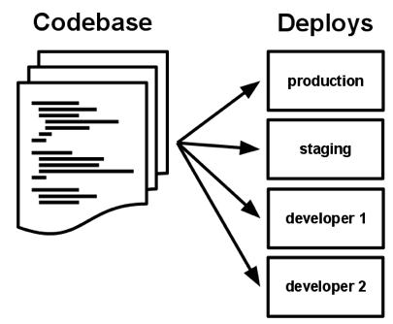
The Twelve Factors
1. Codebase
One codebase tracked in revision control, many deploys
A twelve-factor app is always tracked in a version control system, such as Gits, Mercurial, or Subversion. A copy of the revision tracking database is known as a code repository, often shortened to code repo or just repo.
A codebase is any single repo (in a centralized revision control system like Subversion), or any set of repos who share a root commit (in a decentralized revision control system like Git).
2. Dependencies
Explicitly declare and isolate dependencies
A twelve-factor app never relies on implicit existence of system-wide packages. It declares all dependencies, completely and exactly, via a dependency declaration manifest. Furthermore, it uses a dependency isolation tool during execution to ensure that no implicit dependencies “leak in” from the surrounding system. The full and explicit dependency specification is applied uniformly to both production and development. One benefit of explicit dependency declaration is that it simplifies setup for developers new to the app. The new developer can check out the app’s codebase onto their development machine, requiring only the language runtime and dependency manager installed as prerequisites.

Slide 17
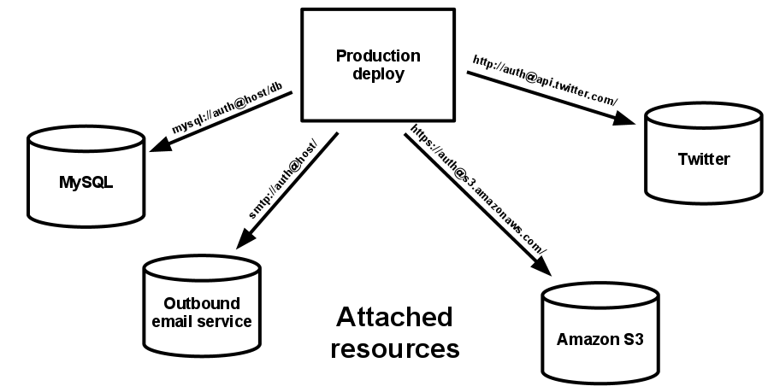
3. Config
Store config in the environment
An app’s config is everything that is likely to vary between deploys (staging, production, developer environments, etc). This includes:
Resource handles to the database, Memcached, and other backing services
Credentials to external services such as Amazon S3 or Twitter
Per-deploy values such as the canonical hostname for the deploy
Apps sometimes store config as constants in the code. This is a violation of twelve-factor, which requires strict separation of config from code. Config varies substantially across deploys, code does not.
4. Backing services
Treat backing services as attached resources
A backing service is any service the app consumes over the network as part of its normal operation. Examples include datastores (such as MySQL or CouchDB), messaging/queueing systems (such as RabbitMQ or Beanstalkd), SMTP services for outbound email (such as Postfix), and caching systems (such as Memcached).

Slide 18
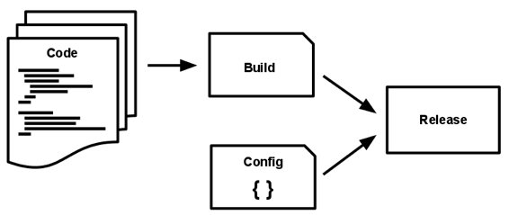
5. Build, release, run
Strictly separate build and run stages
A codebase is transformed into a (non-development) deploy through three stages:
The build stage is a transform which converts a code repo into an executable bundle known as a build. Using a version of the code at a commit specified by the deployment process, the build stage fetches vendors dependencies and compiles binaries and assets.
The release stage takes the build produced by the build stage and combines it with the deploy’s current config. The resulting release contains both the build and the config and is ready for immediate execution in the execution environment.
The run stage (also known as “runtime”) runs the app in the execution environment, by launching some set of the app’s processes against a selected release.
6. Processes
Execute the app as one or more stateless processes
The app is executed in the execution environment as one or more processes. Twelve-factor processes are stateless and share-nothing. Any data that needs to persist must be stored in a stateful backing service, typically a database.
The memory space or filesystem of the process can be used as a brief, single-transaction cache.

Slide 19
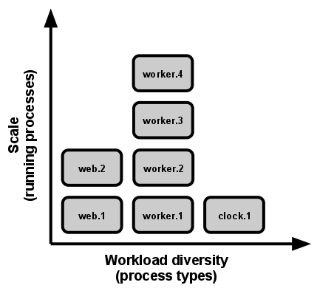
7. Port binding
Export services via port binding
Web apps are sometimes executed inside a webserver container. For example, PHP apps might run as a module inside Apache HTTPD, or Java apps might run inside Tomcat.
The twelve-factor app is completely self-contained and does not rely on runtime injection of a webserver into the execution environment to create a web-facing service. The web app exports HTTP as a service by binding to a port, and listening to requests coming in on that port.
8. Concurrency
Scale out via the process model
The process model truly shines when it comes time to scale out. The share-nothing, horizontally partitionable nature of twelve-factor app processes means that adding more concurrency is a simple and reliable operation. The array of process types and number of processes of each type is known as the process formation.

Slide 20
9. Disposability
Maximize robustness with fast startup and graceful shutdown
The twelve-factor app’s processes are disposable, meaning they can be started or stopped at a moment’s notice. This facilitates fast elastic scaling, rapid deployment of code or config changes, and robustness of production deploys.
Processes should strive to minimize startup time. Ideally, a process takes a few seconds from the time the launch command is executed until the process is up and ready to receive requests or jobs. Short startup time provides more agility for the release process and scaling up; and it aids robustness, because the process manager can more easily move processes to new physical machines when warranted.
10. Dev/prod parity
Keep development, staging, and production as similar as possible
There have been substantial gaps between development (a developer making live edits to a local deploy of the app) and production (a running deploy of the app accessed by end users). These gaps manifest in three areas:
The time gap: A developer may work on code that takes days, weeks, or even months to go into production.
The personnel gap: Developers write code, ops engineers deploy it.
The tools gap: Developers may be using a stack like Nginx, SQLite, and OS X, while the production deploy uses Apache, MySQL, and Linux.
The twelve-factor app is designed for continuous deployment by keeping the gap between development and production small. Looking at the three gaps described above:
Make the time gap small: a developer may write code and have it deployed hours or even just minutes later.
Make the personnel gap small: developers who wrote code are closely involved in deploying it and watching its behavior in production.
Make the tools gap small: keep development and production as similar as possible.

Slide 21
11. Logs
Treat logs as event streams
Logs provide visibility into the behavior of a running app. In server-based environments they are commonly written to a file on disk (a “logfile”); but this is only an output format.
Logs are the stream of aggregated, time-ordered events collected from the output streams of all running processes and backing services. Logs in their raw form are typically a text format with one event per line (though backtraces from exceptions may span multiple lines). Logs have no fixed beginning or end, but flow continuously as long as the app is operating.
12. Admin processes
Run admin/management tasks as one-off processes
The process formation is the array of processes that are used to do the app’s regular business (such as handling web requests) as it runs. Separately, developers will often wish to do one-off administrative or maintenance tasks for the app, such as:
Running database migrations
Running a console (also known as a REPL shell) to run arbitrary code or inspect the app’s models against the live database. Most languages provide a REPL by running the interpreter without any arguments or in some cases have a separate command
Running one-time scripts committed into the app’s repo
One-off admin processes should be run in an identical environment as the regular long-running processes of the app. They run against a release, using the same codebase and config as any process run against that release. Admin code must ship with application code to avoid synchronization issues.

Slide 22
Software Development LifeCycle

Slide 23
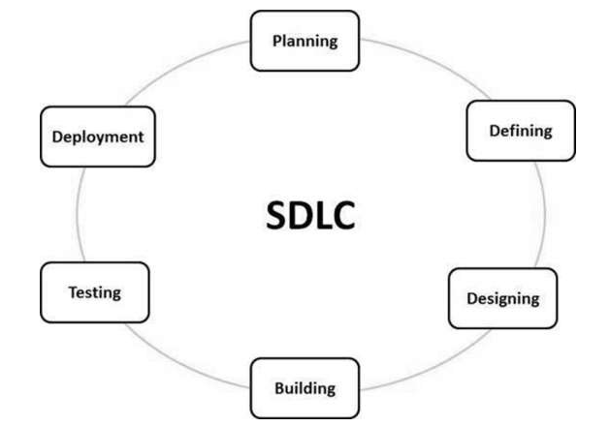
SDLC- Software Development Life Cycle (SDLC) is a process used by the software industry to design, develop and test high quality softwares. It consists of a detailed plan describing how to develop, maintain, replace and alter or enhance specific software. The life cycle defines a methodology for improving the quality of software and the overall development process.

Slide 24
The Software Development Lifecycle
1. Concept Projects are envisioned, designed, and prioritized. Confluence is a great tool to develop product research documents and share design files during this stage.
2. Planning/Roadmap Stakeholders are identified, budgets set, and infrastructure requisitioned. Design documents from the concept phase are broken down into actionable tasks. Jira and Trello manage, track, and organize these task lists.
3. Code/Review/Test Development teams work to build production ready software that meets requirements and feedback. CI/CD pipelines ensure efficient developer experience. Bitbucket offers collaborative code review tools and CI/CD pipelines which plugin to the code review process.
4. Deploy/Release and Hosting With code approved and merged, it’s time to ship it. Bitbuckets CI/CD pipelines makes deployments as easy as clicking a button. The live production code will need a place to live. Consider using cloud hosting provided by Amazon AWS, Google Cloud Platform, or Microsoft Azure.
5. IT Support Support and maintenance is required of active software projects. Jira Service Desk provides powerful tools to capture, triage, and resolve customer support requests.
6. Incident Management Deprecation and end-of-life activities, including customer notification and migration are software development best practices.

Slide 25
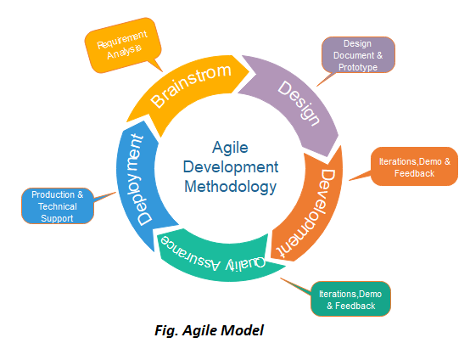
Agile Model- Agile methods break tasks into smaller iterations, or parts do not directly involve long term planning. The project scope and requirements are laid down at the beginning of the development process. Plans regarding the number of iterations, the duration and the scope of each iteration are clearly defined in advance.

Slide 26
Phase-
Requirements gathering
Design the requirements
Construction/iteration
Testing/quality
Deployment
Feedback
Applications-
When frequent changes are required.
When a highly qualified and experienced team is available.
When a customer is ready to have a meeting with a software team all the time.
When project size is small.

Slide 27
Project Management

Slide 28
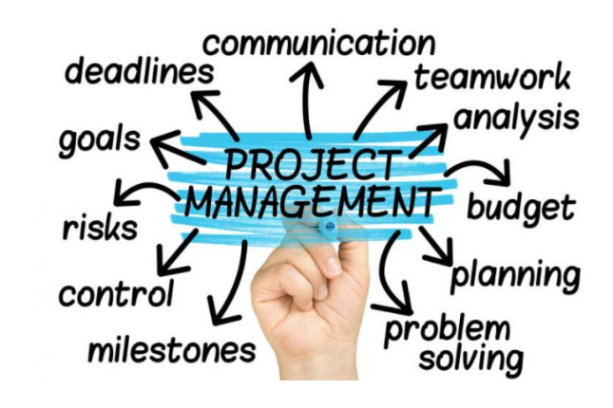
Project Management-
Project management is the art of making a plan, then executing it.
Skills-
Communication- Communicate between team members.
Time Management- Manage time.
Problem Solving- Probably solve lots of problems in our regular role.
Organizational awareness- Get familier with other projects that might need the same people and resources at the same time we are going to need them.
Diplomacy- Be prepared to negotiate scheduling ,conflicting priorities and personality clashes with grace.

Slide 29
Project management focuses on four aspects of the project known as the 4 P’s:
People - The most important element of a successful project. (recruiting, selection, performance management, training, compensation, career development, organization, work design, team/culture development)
Product - The software to be built (product objectives, scope, alternative solutions, constraint)
Process - The set of framework activities and software engineering tasks to get the job done (framework activities populated with tasks, milestones, work products, and QA points)
Project - All work required to make the product a reality. (planning, monitoring, controlling)

Slide 30
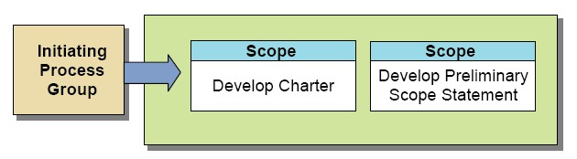
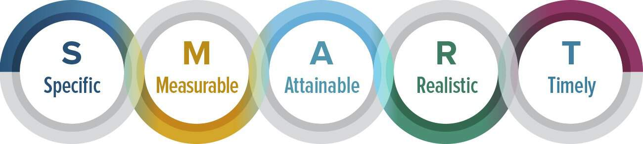
Steps-
1. Initiating- This is the start of the project and the goal of this phase is to define the project at a broad level. This phase usually begins with a business case.
2. Planning- This phase is key to successful project management and focuses on developing a roadmap that everyone will follow. This phase typically begins with setting goals. Two of the more popular methods for setting goals are S.M.A.R.T and C.L.E.A.R.
S.M.A.R.T- This method helps ensure that the goals have been thoroughly vetted. It also provides a clearly understand the implications of the goal setting process.
S- To set specific goals, answer the following questions: who, where, what, when, which, why.
M- Create criteria that we can use to measure the success of a goal.
A- Identify the most important goals and what it will take to achieve them.
R- We should be willing and able to work toward a particular goal.
T- Create a timeframe to achieve the goal.

Slide 31
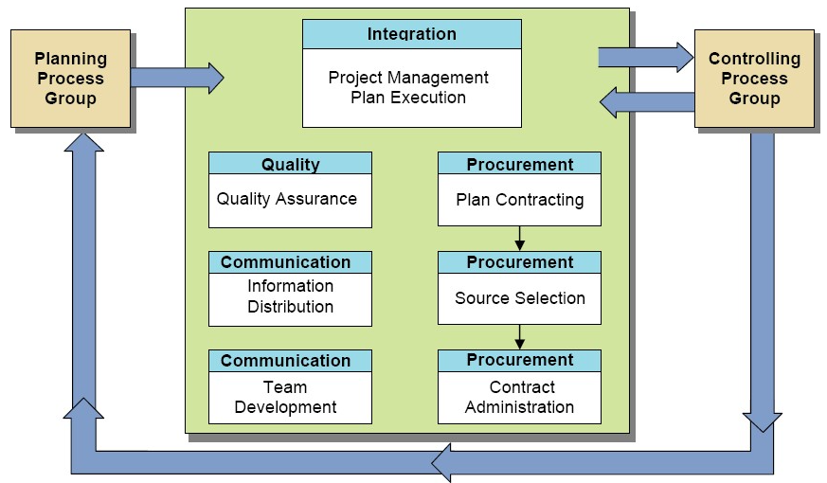
C.L.E.A.R- A newer method for setting goals that takes into consideration the environment of today’s fast-paced business.
C- The goal should encourage employees to work together.
L- They should be limited in scope and time to keep it managerable.
E- Goals should tap into the passion of employees and be something they can form an emotional connection to. This can optimize the equality of work.
A- Break larger goals into smaller tasks that can be quickly achieved.
R- As new situation arise, be flexible and refine goals as needed.
3. Executing- The execution/implementation phase ensures that the project management plan's deliverables are executed accordingly. This phase involves proper allocation, co-ordination and management of human resources and any other resources such as material and budgets. The output of this phase is the project deliverables.

Slide 32
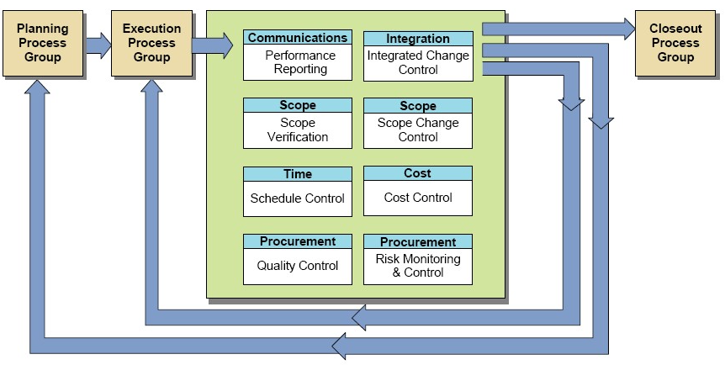
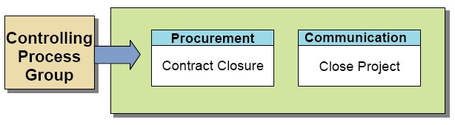
4. Monitor & Controlling- Monitoring and controlling consists of those processes performed to observe project execution so that potential problems can be identified in a timely manner and corrective action can be taken, when necessary, to control the execution of the project. The key benefit is that project performance is observed and measured regularly to identify variances from the project management plan.
5. Closing- Closing includes the formal acceptance of the project and the ending thereof.

Slide 33
Lean Project Management

Slide 34
Lean Project Management- Lean project management is the application of lean manufacturing principles to the practice of project management. The goal of lean project management is to maximize value while minimizing waste.
"Lean" is a systematic method for the elimination of waste ("Muda") within a manufacturing system. Lean also takes into account waste created through overburden ("Muri") and waste created through unevenness in work loads ("Mura"). Working from the perspective of the client who consumes a product or service, "value" is any action or process that a customer would be willing to pay for.
Two well-known types are "Kanban" and " Last Planner System".
The term Kanban comes from manufacturing but was adapted for software development by David Anderson when he was working at Microsoft in 2005 and inherited an underperforming maintenance team. ^{[7]} The success of the approach in that environment, led Anderson to experiment with Kanban in projects, with similarly positive results. As Anderson publicised his findings through talks and his book, software developers began to experiment with Kanban and it is now one of the most widely used methods for managing agile software development projects.
The Last Planner System is used principally in construction and particularly focuses on pull and flow but perhaps more important than those is its emphasis on a collaborative approach in which all trades work together to create a visual representation of the work that needs to be done.

Slide 35
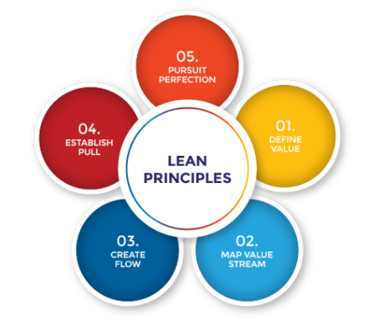
Principle- The five principles are considered a recipe for improving workplace efficiency and include:
1) Defining value
2) Mapping the value stream
3) Creating flow
4) Using a pull system
5) Pursuing perfection.
Benefits-
Reduced lead times
Lower inventory—and therefore lower storage costs
Decreased overall costs
Improved productivity and efficiency
Greater quality
Higher customer satisfaction

Slide 36


